Slide 1
From quote to installed, and back again
Revenue Cloud + Field Service: the QuantumBit demo story
Demo storyboard · Draft
Notes:
Purpose: walk the audience through one customer lifecycle that crosses Revenue Cloud and Field Service in both directions. Every slide after this maps to something we show live.
Story: high tech, data center. QuantumBit sells PowerSwerve rack servers to Infinitech for its San Francisco data center.
The sale happens the typical way: a seller, over the phone or as the account rep, quotes and orders in Revenue Cloud. Technicians never sell in this story; Field Service starts once the order is activated.

Slide 2
Meet Infinitech
Expanding its San Francisco data center with QuantumBit
WHAT THEY'RE BUYING
THE CAST
PowerSwerve R750 Rack Server
QB-BDL-R750
S
Seller
Quotes and configures
Revenue Cloud
The hardware Field Service installs and maintains
Scenes 1, 4, 9
F
Fulfillment Manager
Watches the orchestration plan
Revenue Cloud
Installation and Assembly
QB-INST-1000
D
Dispatcher
Schedules the field work
Field Service
Becomes the install Work Order
Scenes 2–5
T
Technician
Installs, services, spots growth
Field Service Mobile
Gold Hardware Maintenance
QB-SUPP-1005
Monthly on-site check-ups and break/fix coverage
Billing Specialist
Starts billing at go-live
Revenue Cloud Billing
Scenes 6–7
B
Revenue Cloud personas in blue · Field Service personas in dark blue
Notes:
Set the scene. Infinitech is an existing demo account. The three products are in the QuantumBit catalog today. Introduce the five personas — the story hands off between them.

Slide 3
The demo in nine scenes
One customer, one asset, one continuous loop · about 15 minutes
ACT 1 · REVENUE CLOUD → FIELD SERVICE · SELL, DELIVER, BILL
1
CORE DEMO
2
CORE DEMO
3
CORE DEMO
4
CORE DEMO
5
CORE DEMO
Configure & quote
Activate the order
Automatic dispatch
Technician on site
Billing starts at install
Seller
Fulfillment Manager
Dispatcher
Technician
Billing Specialist
ACT 2 · FIELD SERVICE → REVENUE CLOUD · SERVICE, PROTECT, GROW
6
CORE DEMO
7
CORE DEMO
8
CORE DEMO
9
CORE DEMO
↺ Back to Scene 1
The next quote starts from what the field learned
Maintenance runs itself
Break/fix with coverage check
Upsell from the field
One install base
Service Manager
Dispatcher & Billing
Technician → Seller
Account Team
CORE DEMO
Shown live in the org
Notes:
Use this as the map. Act 1 flows from Revenue Cloud into Field Service; Act 2 flows back. All nine scenes run live in the org.

Slide 4
Act 1 · Revenue Cloud → Field Service
Sell it, deliver it, and start billing when it's actually running

Slide 5
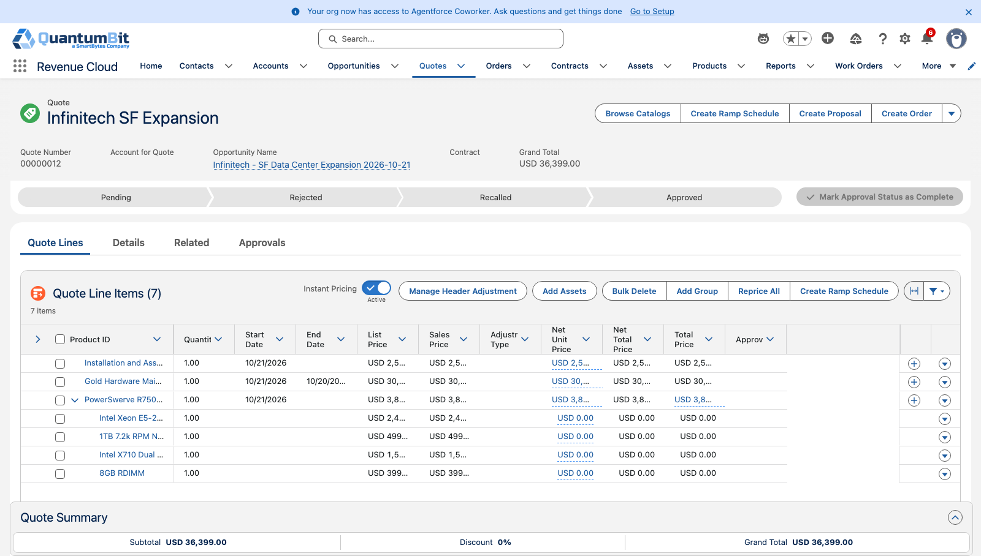
Configure & quote
SCENE 1 · ACT 1
CORE DEMO
Seller · Quote & Configurator
WHAT THE AUDIENCE SEES
A seller builds the Infinitech quote: PowerSwerve R750 server bundle
Installation and Assembly (QB-INST-1000) is quoted with the hardware as a one-time service
Gold Hardware Maintenance adds a year of monthly visits and break/fix coverage
CLICK PATH
1
Open Infinitech opportunity → New Quote
THE MOMENT
2
Add PowerSwerve R750 → Configure
Service is sold with the hardware, so the install is never forgotten.
3
Add Installation and Assembly
4
Add Gold Maintenance → Create Order
Notes:
Start with the seller, working the deal over the phone or as Infinitech's account rep, the way this customer normally buys. Infinitech is expanding its data center and wants QuantumBit servers.
Add the PowerSwerve R750 bundle, then Installation and Assembly as a one-time service so the install is sold with the hardware.
Add Gold Hardware Maintenance at its annual price. Every line we sell here becomes work for Field Service later.

Slide 6
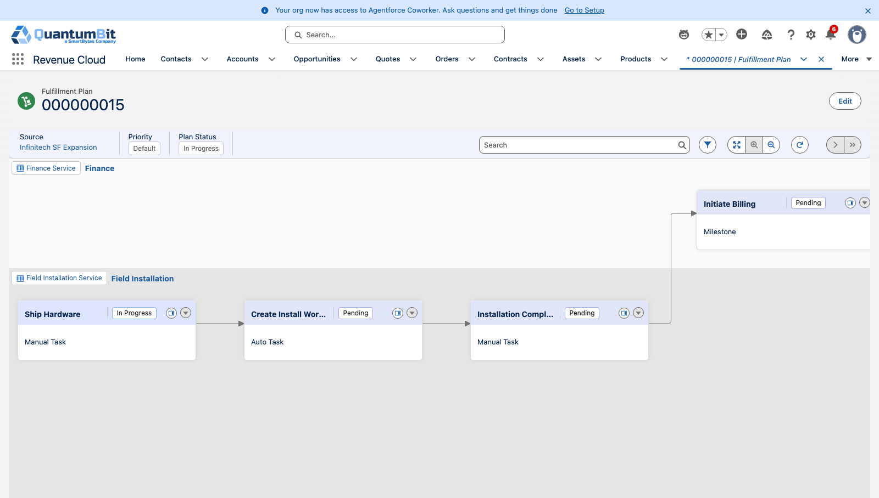
Activate the order
SCENE 2 · ACT 1
CORE DEMO
Fulfillment Manager · Dynamic Revenue Orchestration
WHAT THE AUDIENCE SEES
The quote becomes an activated order with one click
Dynamic Revenue Orchestration breaks the order into a fulfillment plan
Ship → Field Installation → Installation Complete → Initiate Billing
CLICK PATH
1
Quote → Create Order → Activate
THE MOMENT
2
Open the order's fulfillment plan
Billing waits on the install. The plan won't bill until the field says it's done.
3
Walk the steps left to right
4
Point at Initiate Billing waiting on Installation Complete
Notes:
Activate the order and switch to the fulfillment manager. Dynamic Revenue Orchestration decomposed the order into a plan.
Walk the steps: ship hardware, field installation, installation complete, then billing.
The key point: Initiate Billing depends on Installation Complete, so the customer is never billed for equipment that isn't running.

Slide 7
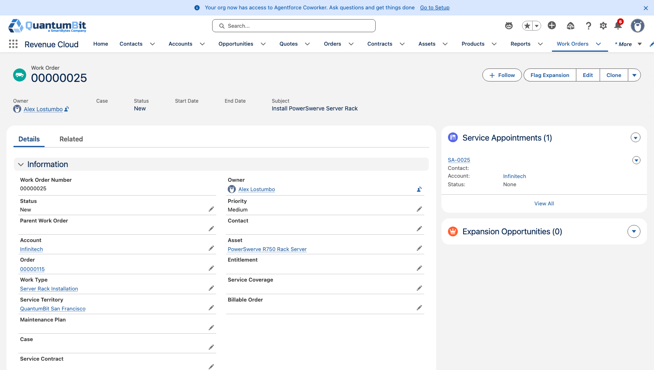
Automatic dispatch
SCENE 3 · ACT 1
CORE DEMO
Dispatcher · Work Orders & Scheduling
WHAT THE AUDIENCE SEES
The Field Installation step creates a Work Order and Service Appointment automatically
The Work Order links back to the Order and the fulfillment step
The appointment lands in the San Francisco territory, ready to schedule
CLICK PATH
1
Open the Field Installation step → related Work Order
THE MOMENT
2
Show Order and Fulfillment Step fields
No re-keying. The order became field work the moment it was activated.
3
Open the Service Appointment
4
Show territory and work type (Server Rack Install)
Notes:
Switch to the dispatcher. Nobody typed this Work Order — the Field Installation step created it, along with a Service Appointment.
Show the Order and Fulfillment Step links on the Work Order. That link is what lets the field close the loop back to Revenue Cloud later.
The work type and territory came from the Field Service setup, so it's ready to schedule.

Slide 8
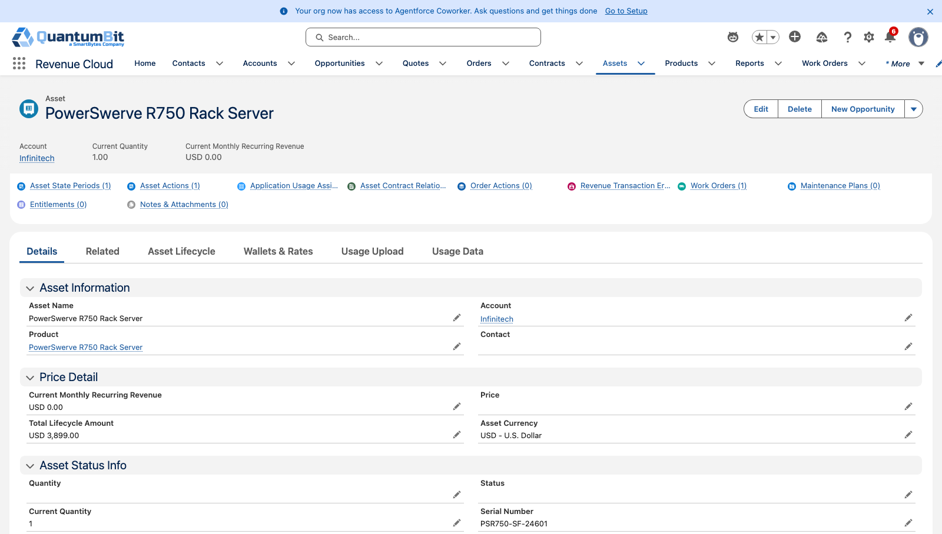
Technician on site
SCENE 4 · ACT 1
CORE DEMO
Technician · Mobile
WHAT THE AUDIENCE SEES
The job goes to a technician with the Server Rack Install skill
On site, the technician records the server serial number on the Asset
The technician completes the Work Order
CLICK PATH
1
Assign the appointment to the certified technician
THE MOMENT
2
Open it on mobile (or the Work Order on desktop)
The person in the field closes the deal's last mile from a phone.
3
Enter the serial number on the Asset
4
Set the Work Order to Completed
Notes:
The appointment goes to a technician who holds the Server Rack Install skill.
On site, they rack the server, record its serial number on the same Asset record Revenue Cloud created, and complete the job.
That single status change is about to start billing.

Slide 9
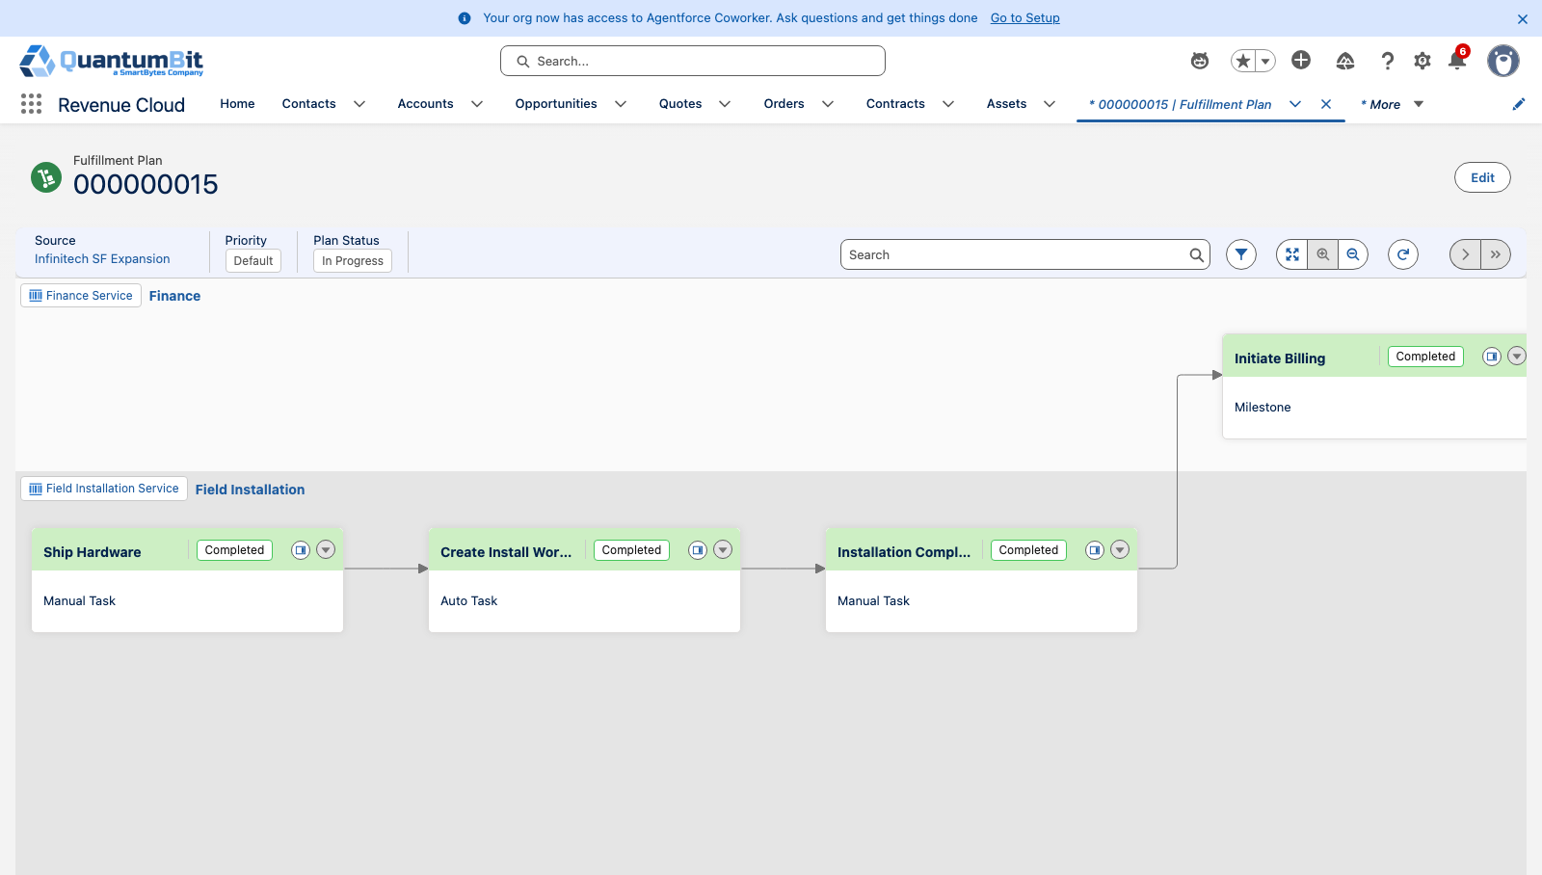
Billing starts at install
SCENE 5 · ACT 1
CORE DEMO
Billing Specialist · Billing
WHAT THE AUDIENCE SEES
Completing the Work Order completes the fulfillment step automatically
Installation Complete accomplishes the billing milestone on the hardware and install lines
The invoice posts on its own, the moment the install is done
CLICK PATH
1
Complete the appointment, then the Work Order
THE MOMENT
2
Fulfillment tab → Installation Complete is done
Revenue starts when value starts. No credits, no disputes.
3
Billing schedule moves out of Waiting for Milestone
4
Open the posted invoice
Notes:
Go back to the fulfillment plan. Installation Complete flipped to done on its own when the technician completed the Work Order.
Billing is released, and the billing schedule starts on the install date.
This is the moment finance cares about: no invoicing for equipment that isn't live, so no credits or disputes.

Slide 10
Act 2 · Field Service → Revenue Cloud
Service it, protect revenue, and grow the account from the field

Slide 11
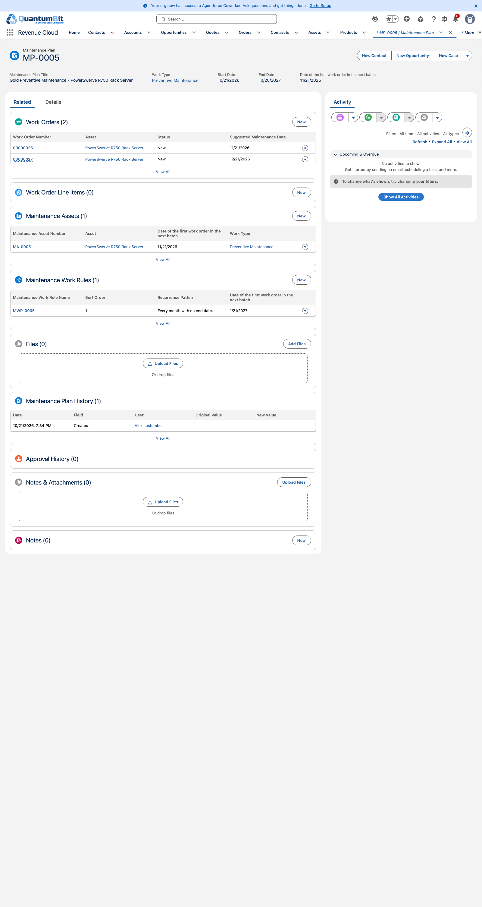
Maintenance runs itself
SCENE 6 · ACT 2
CORE DEMO
Service Manager · Maintenance Plans
WHAT THE AUDIENCE SEES
Gold maintenance on the order creates a Maintenance Plan on the new Asset
Monthly preventive visits are generated as Work Orders automatically
Each visit is tied to the Asset Revenue Cloud sold
CLICK PATH
1
Open the Maintenance Plan from the R750 Asset
THE MOMENT
2
Show the Maintenance Plan created from Gold maintenance
What was promised on the quote is scheduled in the field, automatically.
3
Generate Work Orders → monthly preventive visits
Notes:
Gold maintenance promised monthly on-site check-ups. Here that promise becomes a Maintenance Plan on the Asset, generating the visits automatically.
Nobody in service has to read the contract to know what's owed.

Slide 12
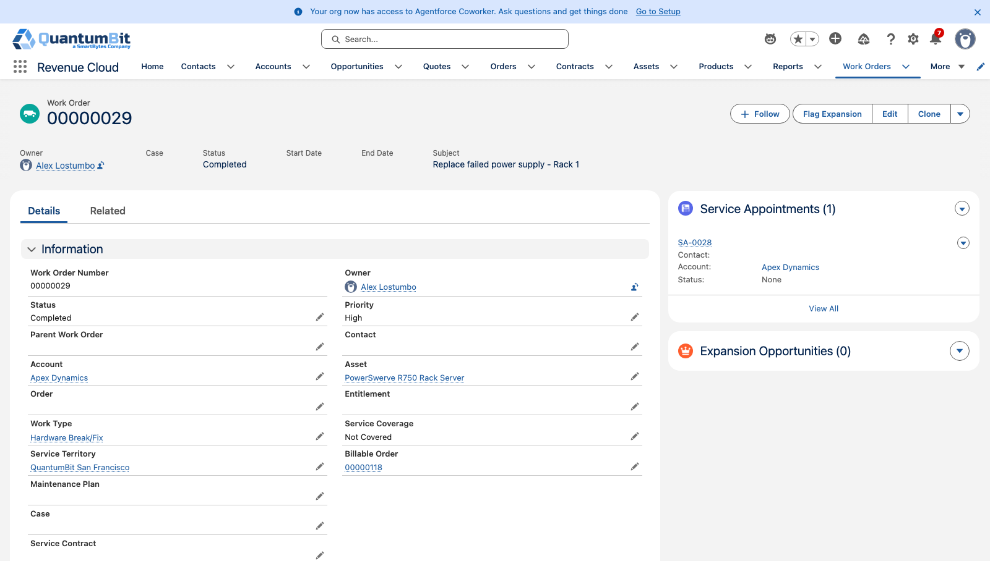
Break/fix with coverage check
SCENE 7 · ACT 2
CORE DEMO
Dispatcher & Billing · Field Service + Revenue Cloud Billing
WHAT THE AUDIENCE SEES
A power supply fails and a break/fix Work Order is opened
Covered by Gold maintenance: no charge to the customer
Not covered: parts and labor become a priced, invoiced order
CLICK PATH
1
Open break/fix Work Order on Infinitech → Covered
THE MOMENT
2
Repeat for Apex Dynamics (no Gold maintenance) → Not Covered
One record decides what the customer pays. Service pays for itself.
3
Complete it → a repair order fills Billable Order
4
Show the posted repair invoice
Notes:
Same failure, two customers. Infinitech has Gold maintenance, so the coverage check says no charge.
A customer without maintenance gets a billable order for parts and labor, priced by Revenue Cloud and invoiced by Billing.
This is the strongest moment of the demo: entitlement and revenue decided by the same record.

Slide 13
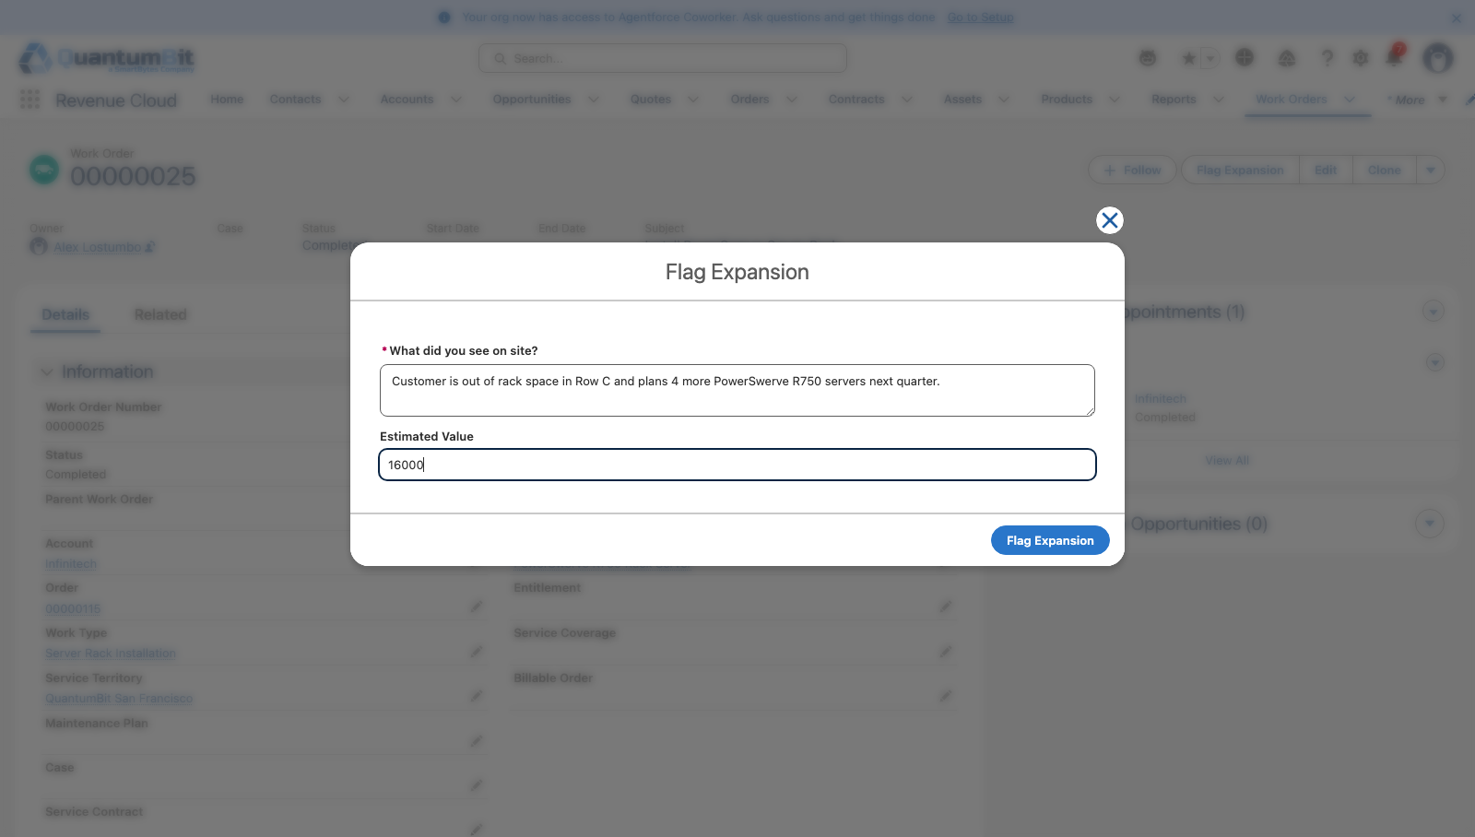
Upsell from the field
SCENE 8 · ACT 2
CORE DEMO
Technician → Seller · Field Service Mobile + Revenue Cloud
WHAT THE AUDIENCE SEES
On site, the technician sees the rack is nearly full
One quick action from the Work Order flags an expansion opportunity
Sales amends the existing asset instead of starting a new deal
CLICK PATH
1
Work Order → Flag Expansion quick action
THE MOMENT
2
Opportunity appears for the account team
Growth starts with the person who's actually in the data center.
3
Seller amends from the Account Assets tab
Notes:
The technician is the only person who's physically seen the customer's rack. One tap flags an expansion opportunity.
The seller amends the existing Asset rather than quoting from scratch, so the new lines co-term with what's already installed.

Slide 14
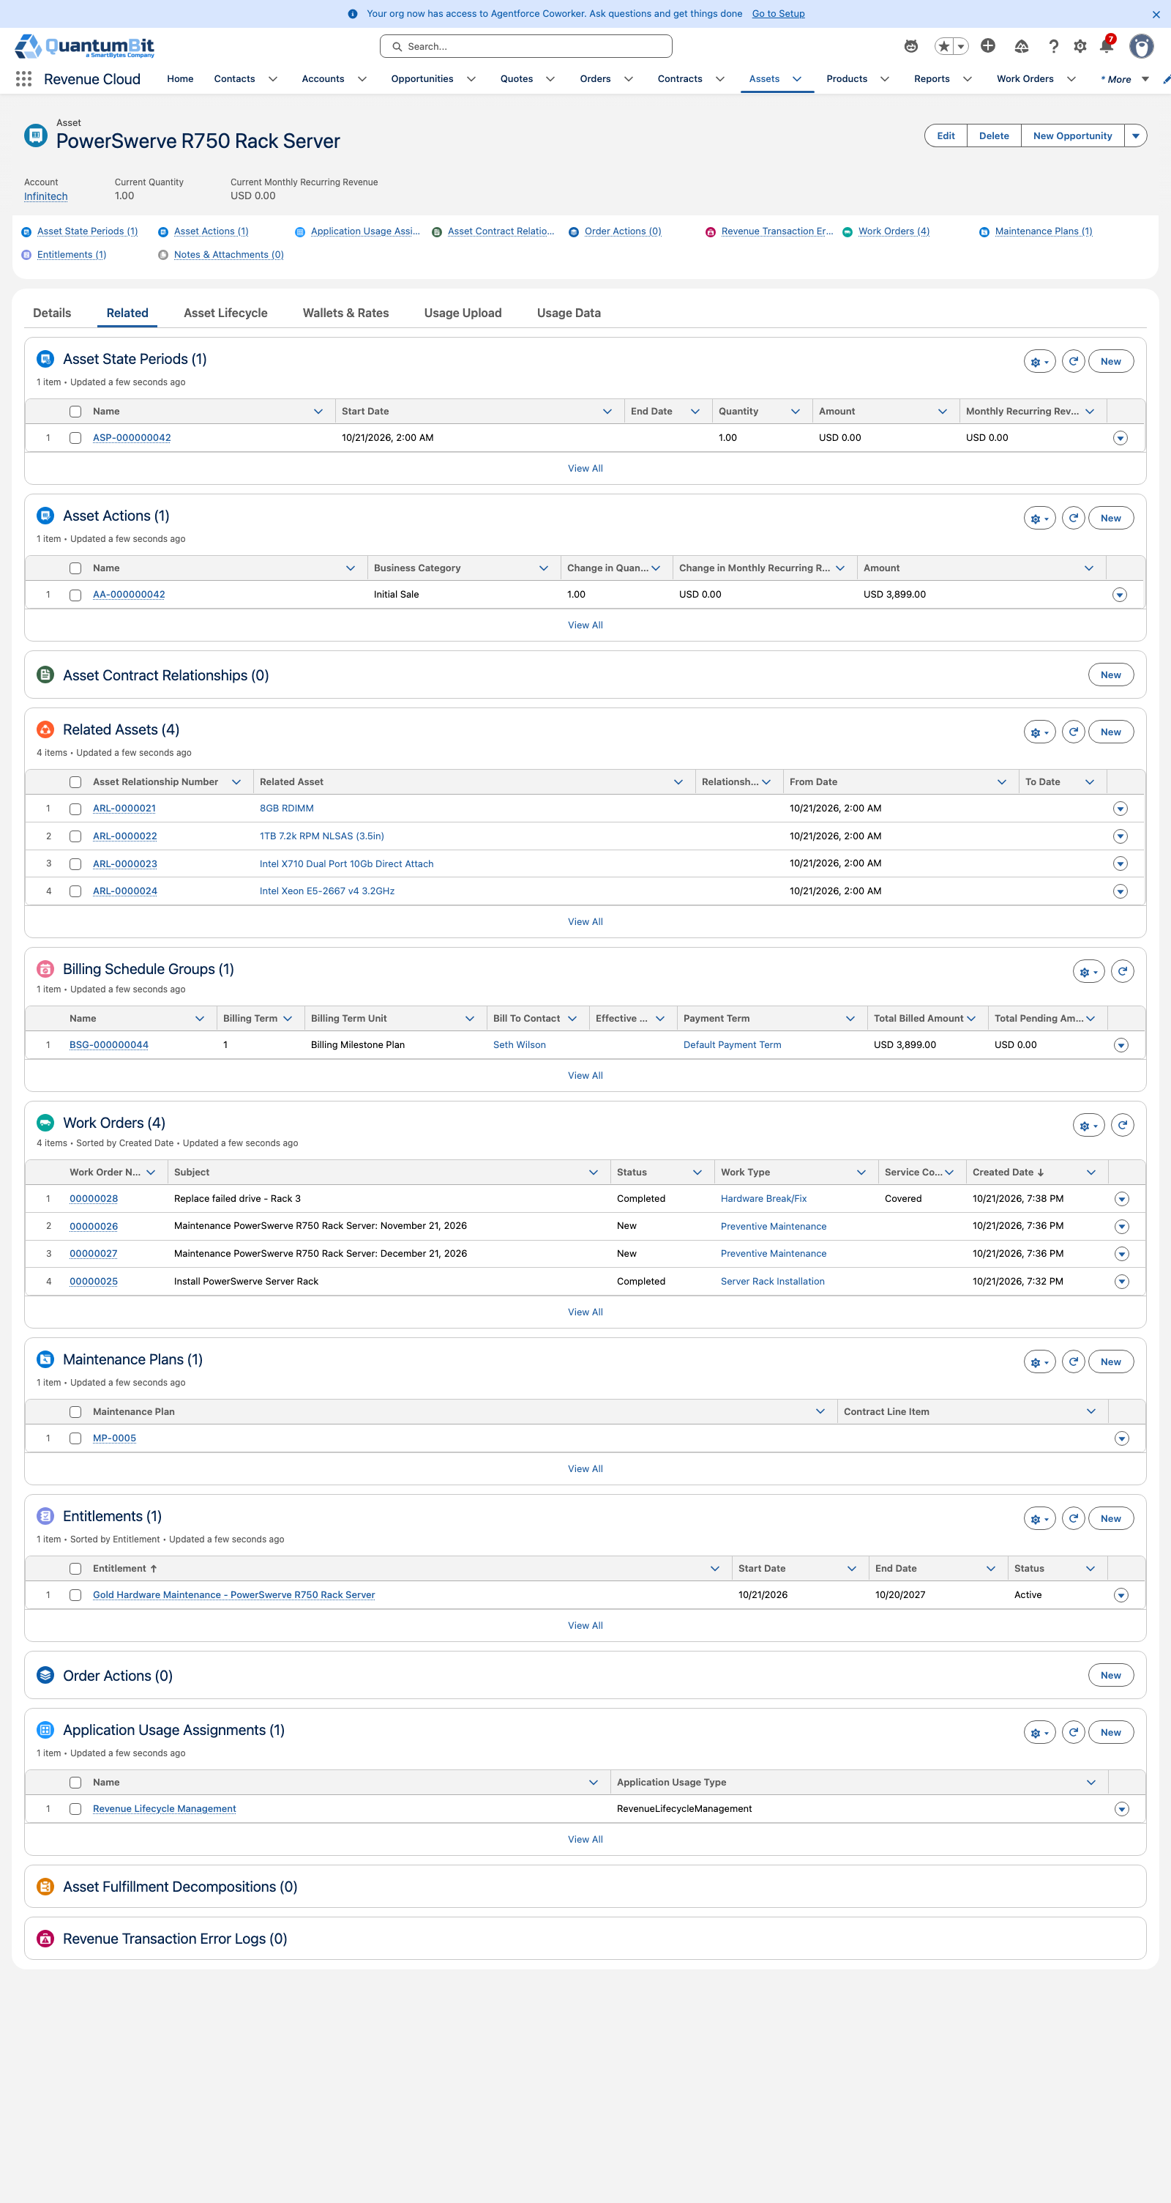
One install base
SCENE 9 · ACT 2
CORE DEMO
Account Team · Asset
WHAT THE AUDIENCE SEES
Revenue Cloud and Field Service work from the same Asset record
Orders, Work Orders, and billing all appear on one Asset
Renewals and amendments quote against what's actually installed
CLICK PATH
1
Open the R750 Asset
THE MOMENT
2
Show related Order and fulfillment history
Sales, service, and finance finally agree on what the customer has.
3
Show related Work Orders and serial number
4
Show billing details
Notes:
Close on the Asset. This one record carries the order, the install Work Order, the serial number, and billing.
There's no integration between two systems because there's one system. When renewal comes, the seller quotes what's really in the rack.

Slide 15
What the audience should walk away with
Three outcomes, each proven by a scene they just watched
1
2
3
No billing before go-live
Service that pays for itself
Growth that starts in the field
Billing waits for the technician to complete the install, so invoices match reality.
Coverage is checked against what was sold. Uncovered work becomes revenue automatically.
Technicians flag expansion, and sellers amend the real install base.
Proven in Scenes 2–5
Proven in Scene 7
Proven in Scenes 8–9
Notes:
Land the three outcomes.

Slide 16
Run of show
Who drives each scene, how long it runs, and the fallback
# | Scene | Persona | App / screen | Min | If it doesn't load
1 | Configure & quote | Seller | Quote & Configurator | 2 | Pre-built quote on Infinitech
2 | Activate the order | Fulfillment Manager | Dynamic Revenue Orchestration | 1.5 | Pre-activated order
3 | Automatic dispatch | Dispatcher | Work Orders & Scheduling | 1.5 | Pre-created Work Order
4 | Technician on site | Technician | Mobile | 2 | Complete from the desktop Work Order
5 | Billing starts at install | Billing Specialist | Billing | 1.5 | Show a pre-completed plan
6 | Maintenance runs itself | Service Manager | Maintenance Plans | 1 | Pre-built records (appendix screenshots)
7 | Break/fix with coverage check | Dispatcher & Billing | Field Service + Revenue Cloud Billing | 2.5 | Pre-built records (appendix screenshots)
8 | Upsell from the field | Technician → Seller | Field Service Mobile + Revenue Cloud | 1.5 | Pre-built records (appendix screenshots)
9 | One install base | Account Team | Asset | 1.5 | Pre-loaded Asset record
 | Total |  |  | 15 | Act 1 only: 8.5 min
Notes:
Timings are targets. Prep the fallbacks in the demo org before the call so any scene can be shown from a pre-built record.

Slide 17
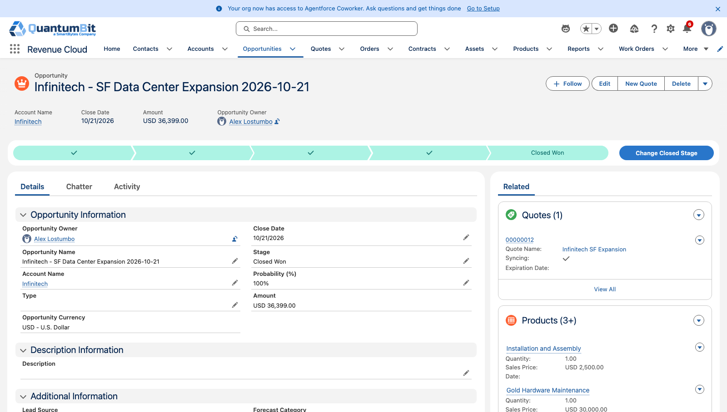
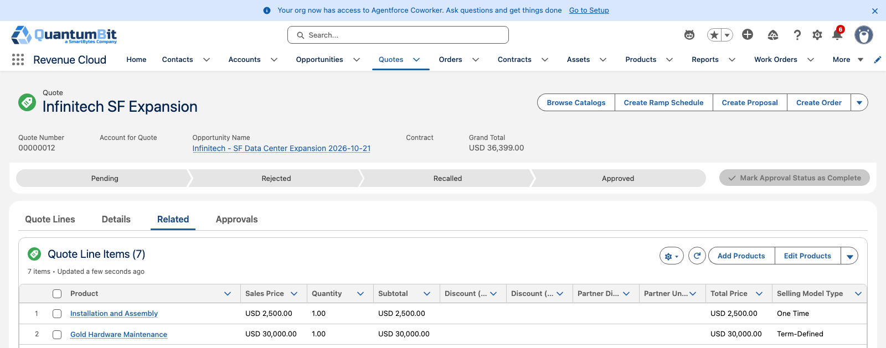
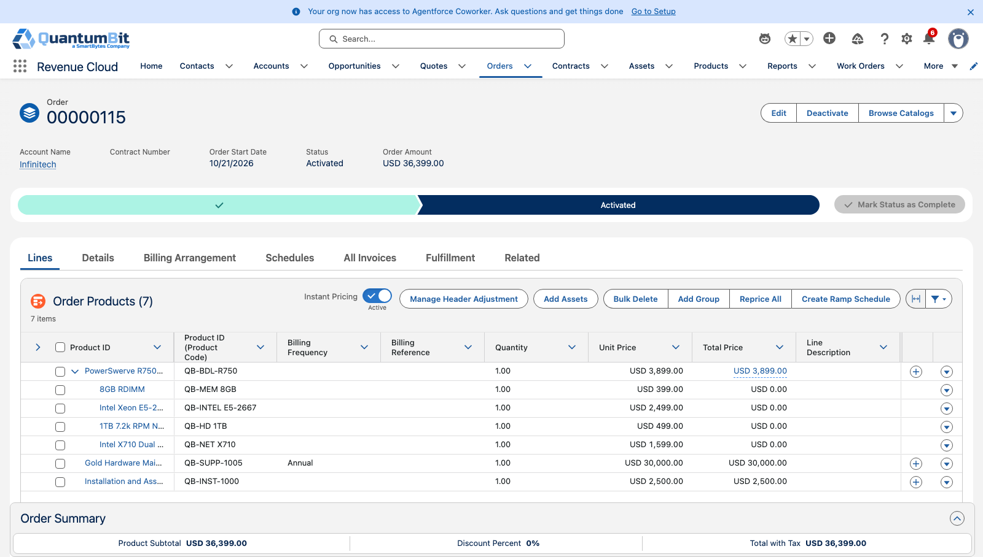
Scene 1 · Configure & quote
Screenshots from the fsl-rc org run
Infinitech opportunity
Quote with hardware, install and Gold
Quote lines and pricing
Activated order

Slide 18
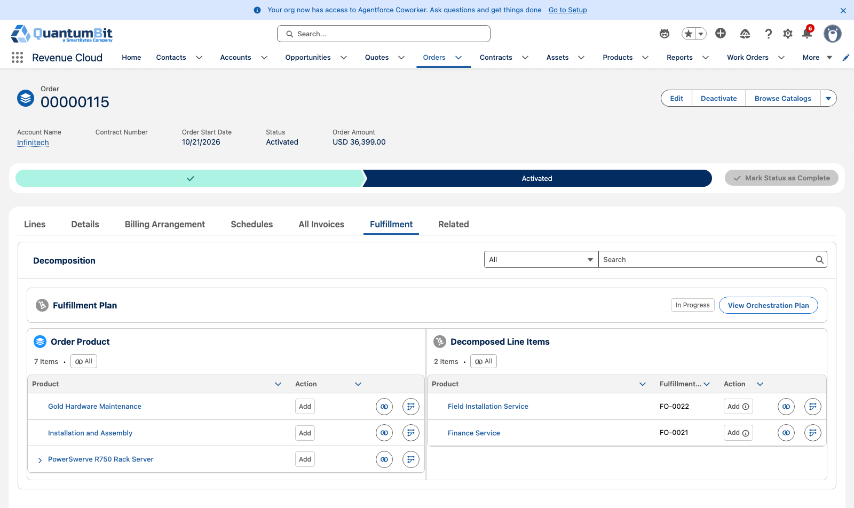
Scene 2 · Activate the order
Screenshots from the fsl-rc org run
Order Fulfillment tab: plan waiting on Ship Hardware
Fulfillment plan

Slide 19
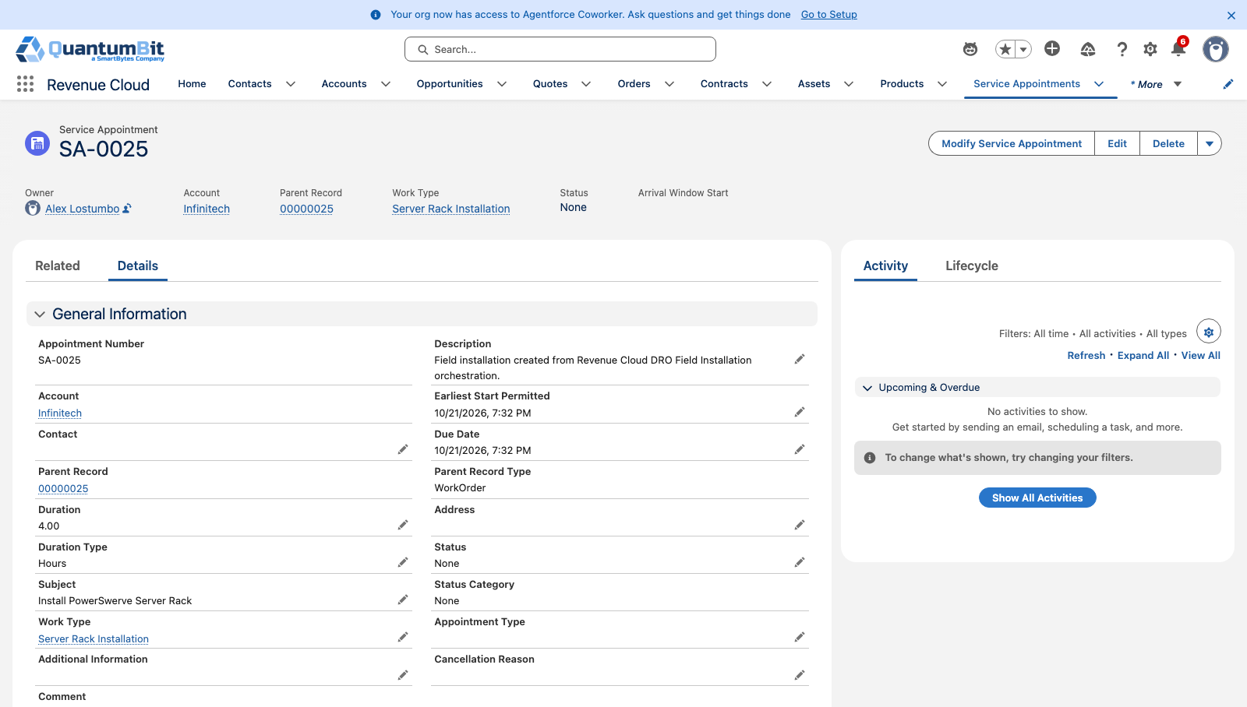
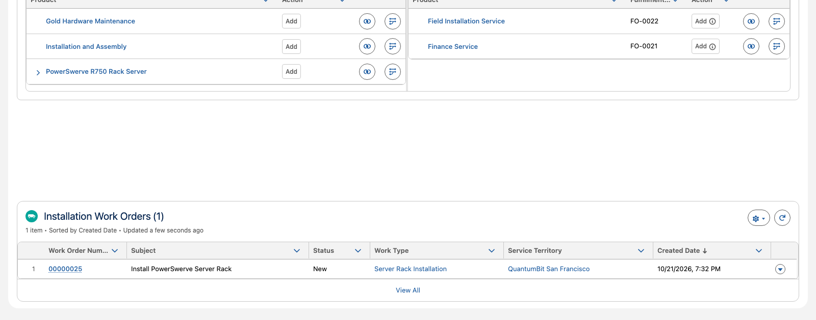
Scene 3 · Automatic dispatch
Screenshots from the fsl-rc org run
Install Work Order linked to Order, step and Asset
Service Appointment in the San Francisco territory
Installation Work Orders on the Order

Slide 20
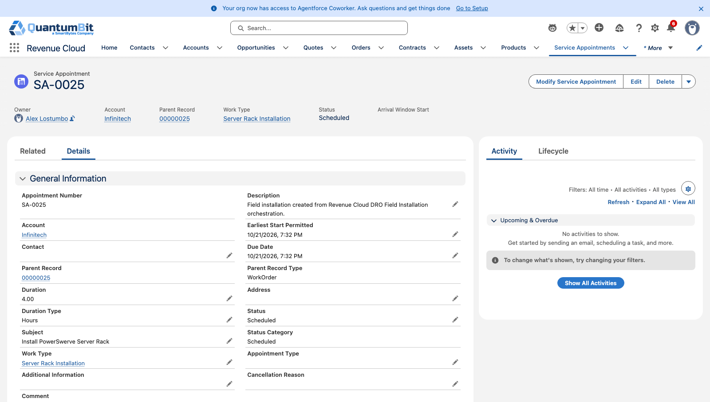
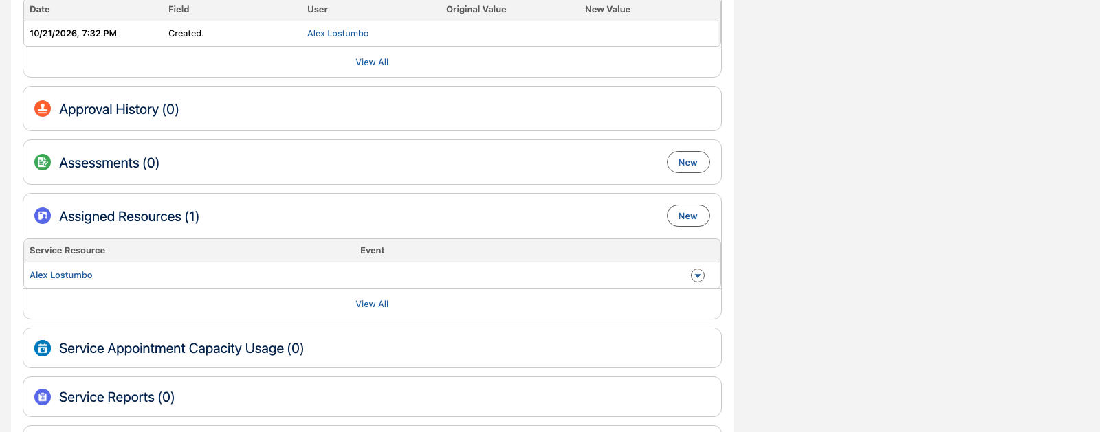
Scene 4 · Technician on site
Screenshots from the fsl-rc org run
Appointment scheduled
Technician assigned
Serial number on the Asset

Slide 21
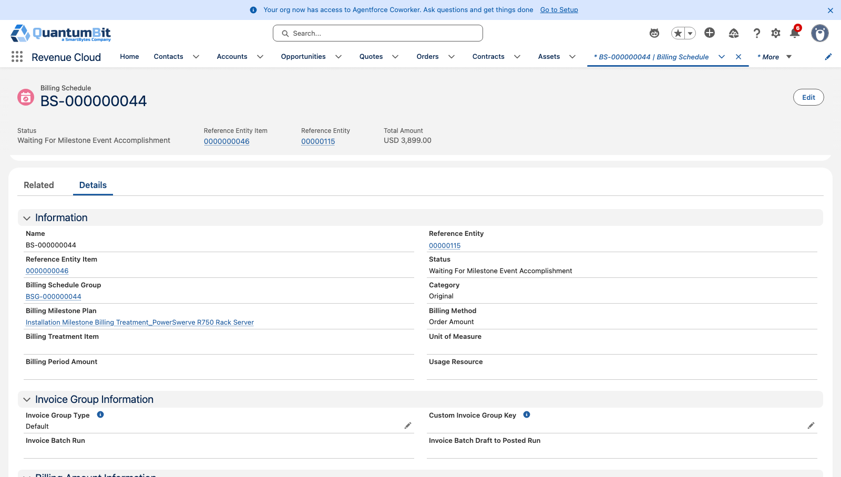
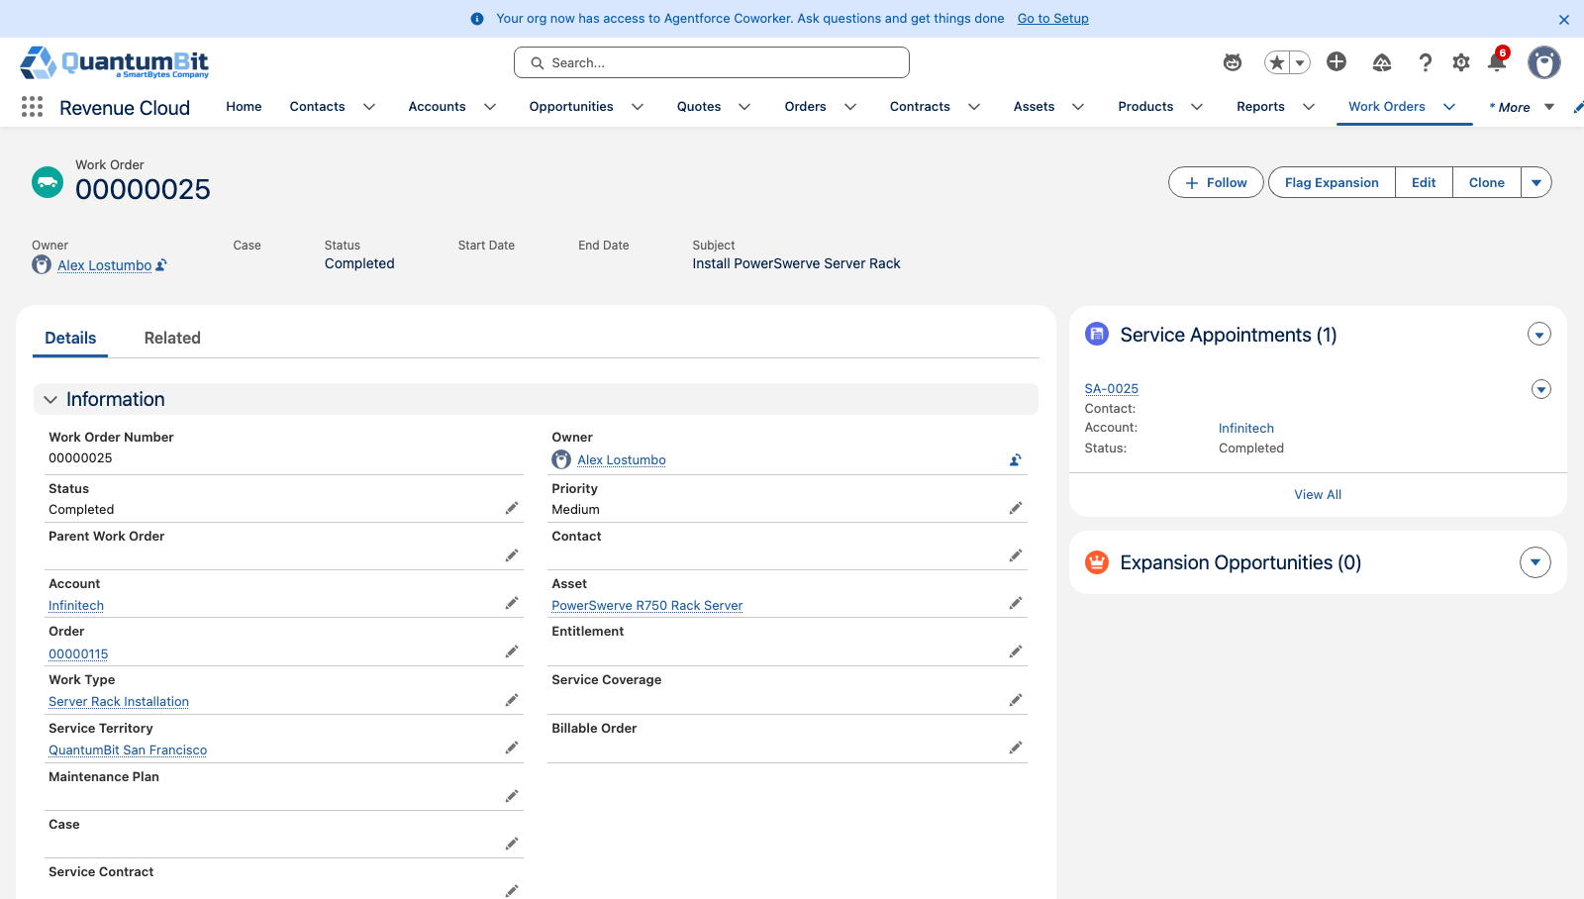
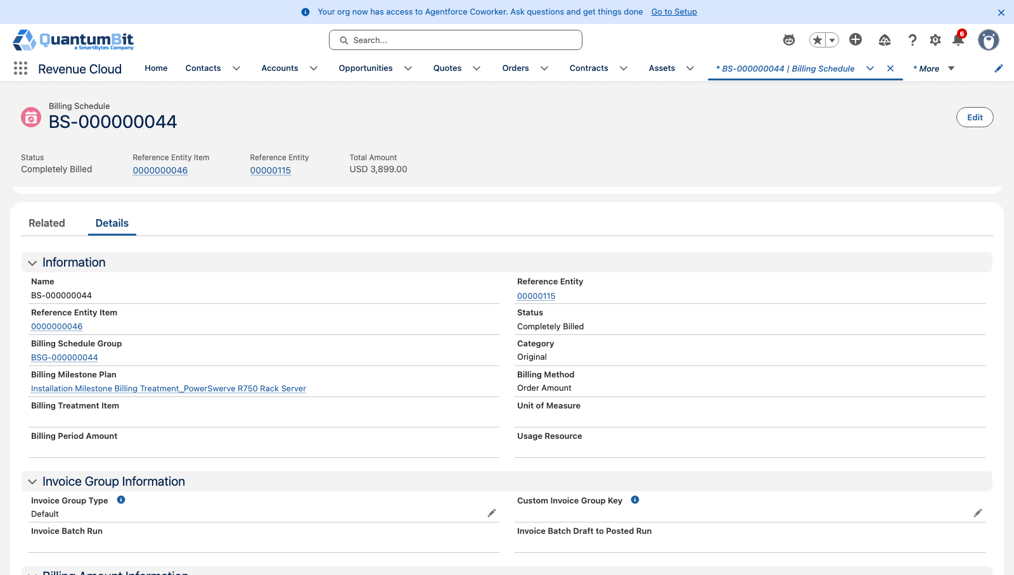
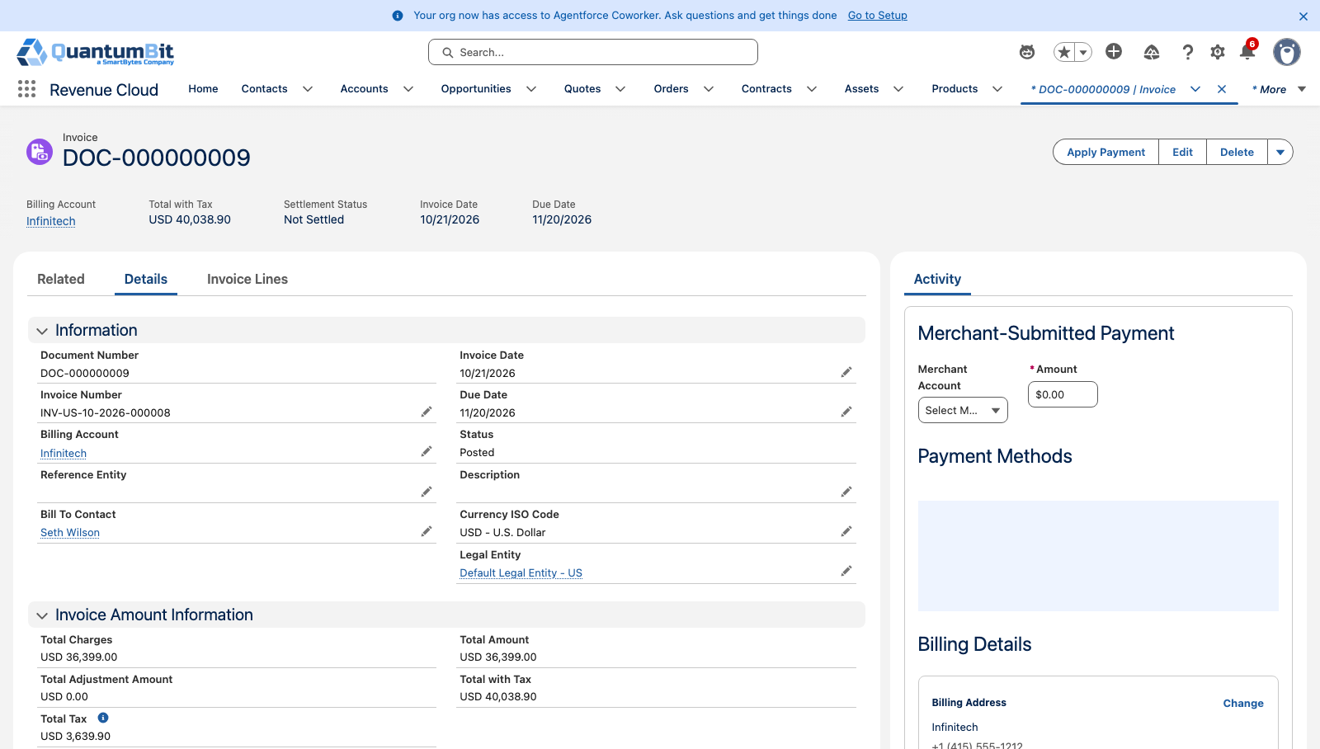
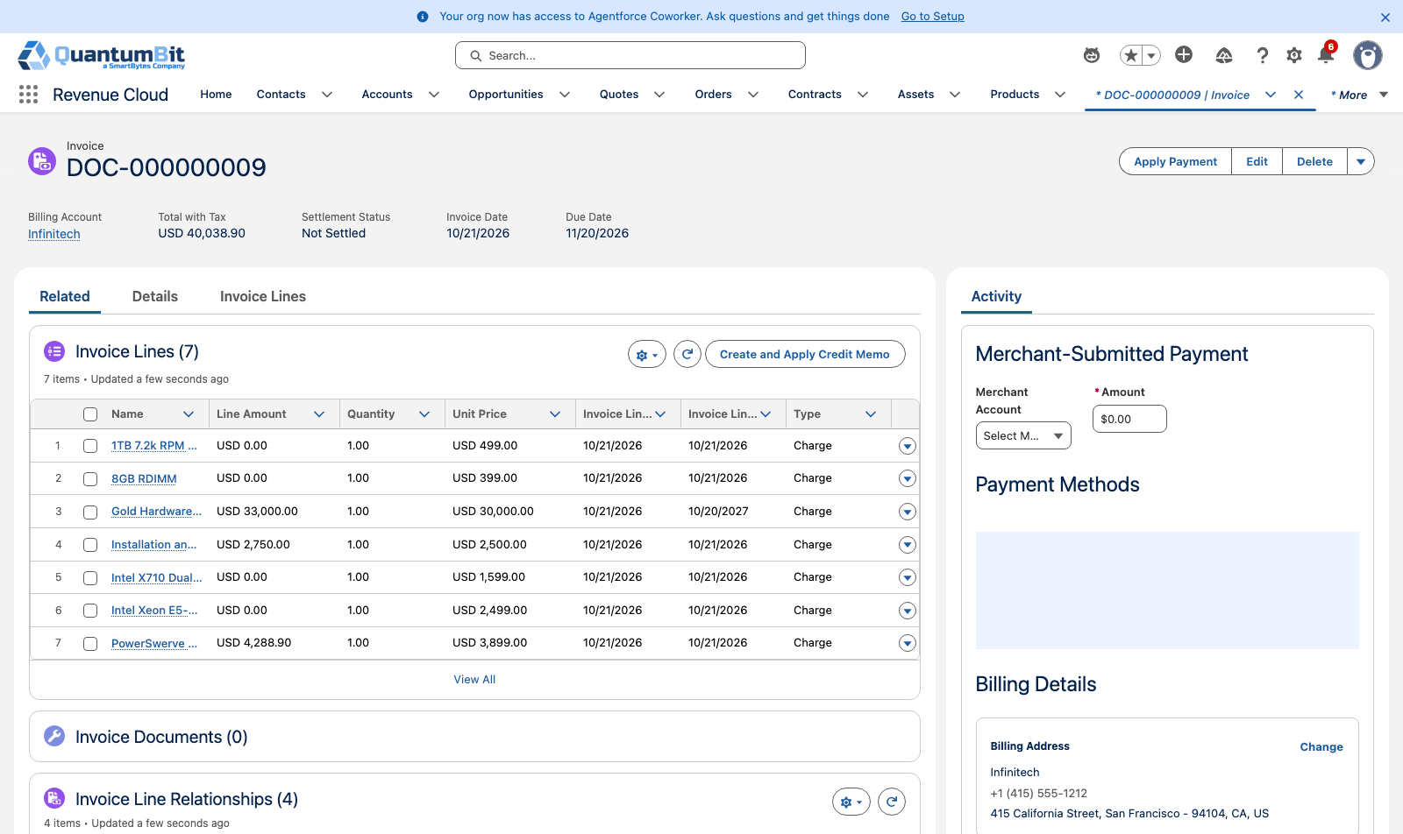
Scene 5 · Billing starts at install
Screenshots from the fsl-rc org run
Billing schedule waiting for the install milestone
Install Work Order completed
Plan after the install: every step completed
R750 billing schedule: Completely Billed
Invoice posted automatically
Invoice lines: hardware, install, Gold

Slide 22
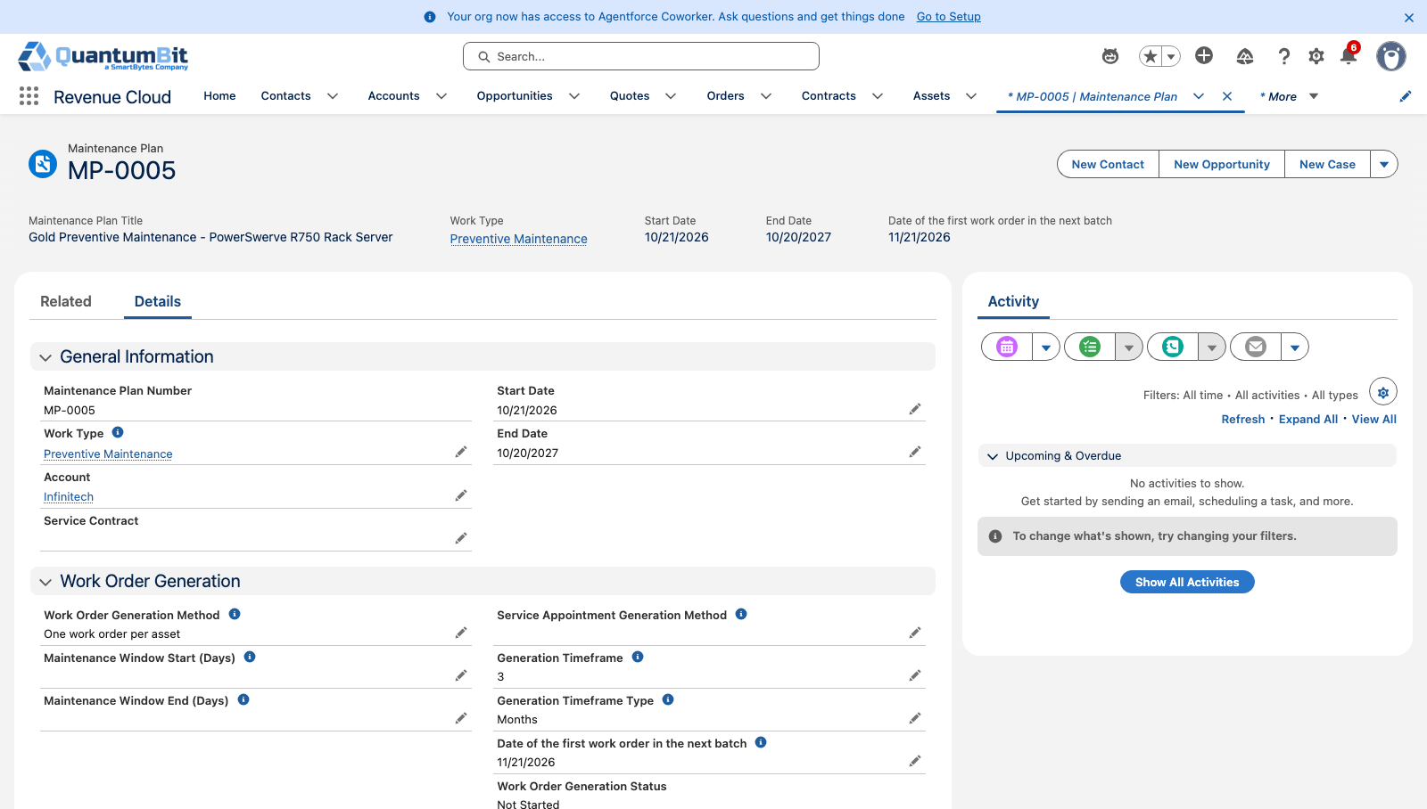
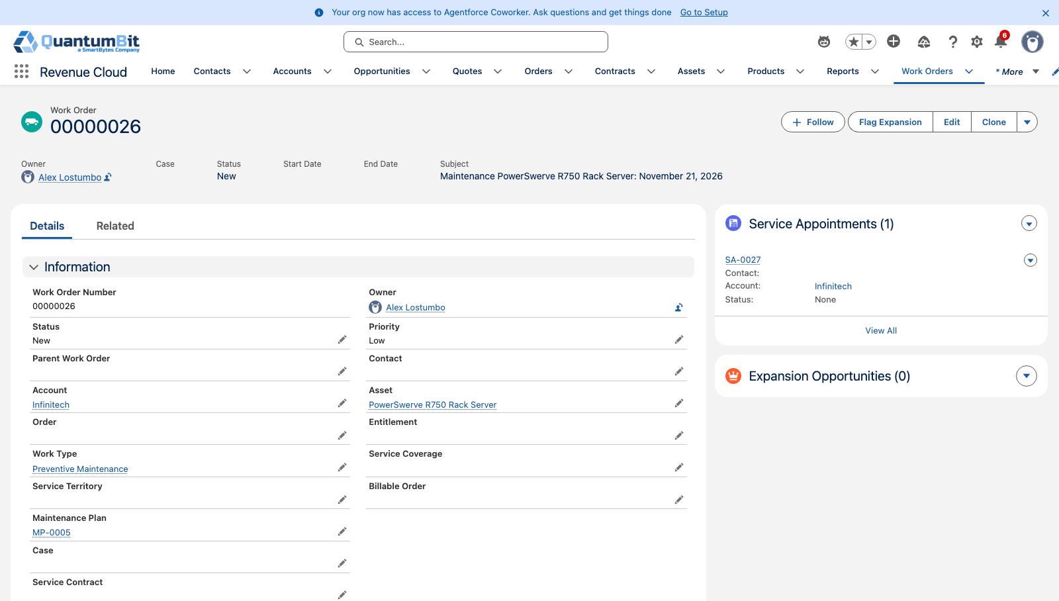
Scene 6 · Maintenance runs itself
Screenshots from the fsl-rc org run
Gold Maintenance Plan on the Asset
Generated preventive Work Orders
Preventive maintenance Work Order

Slide 23
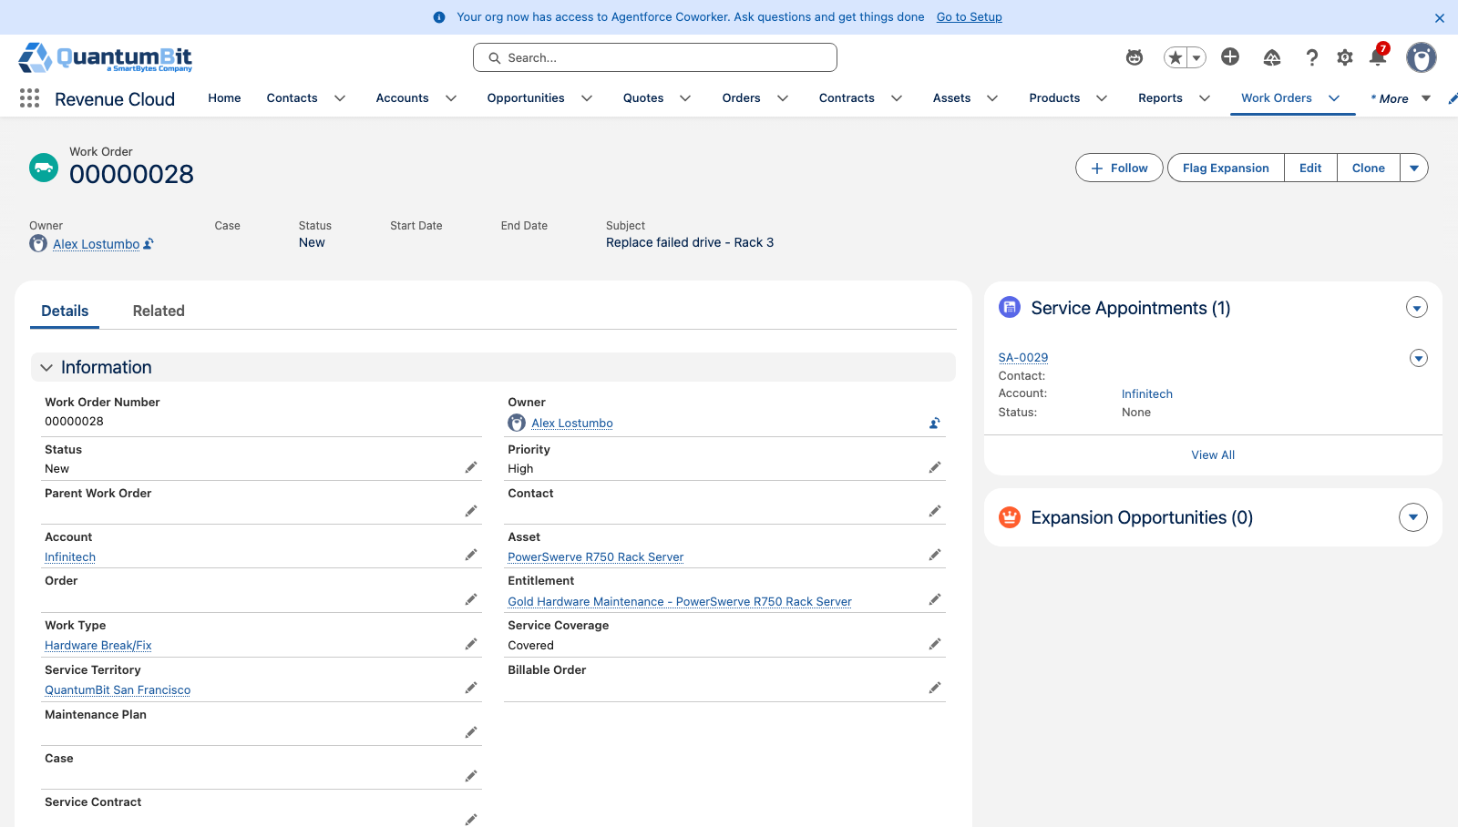
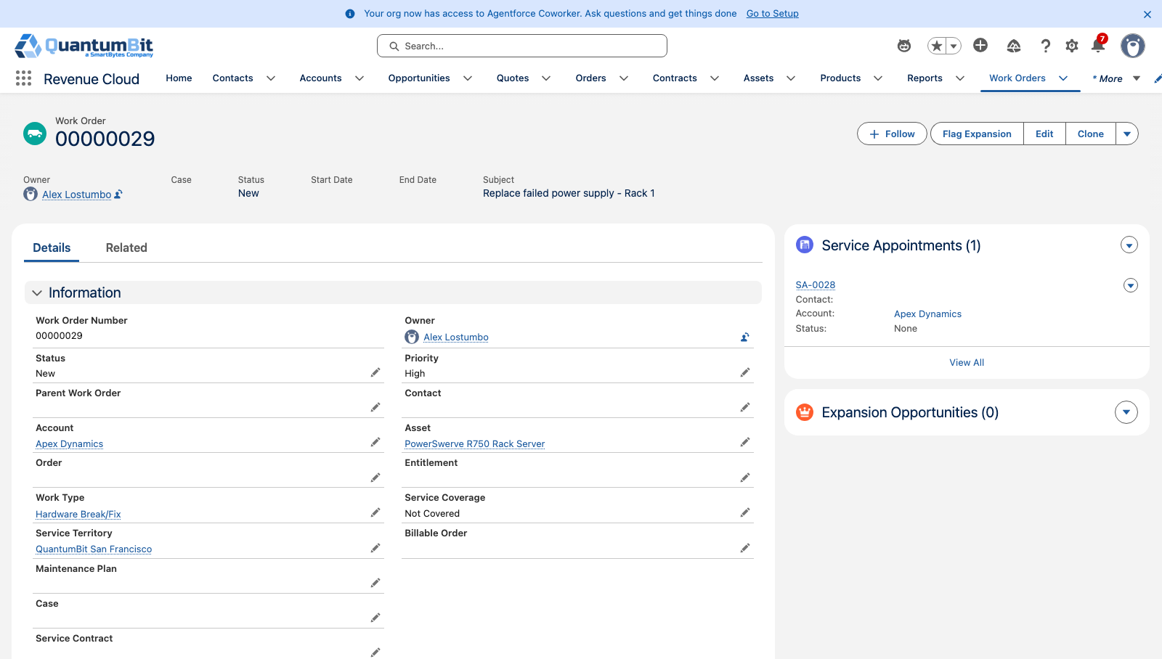
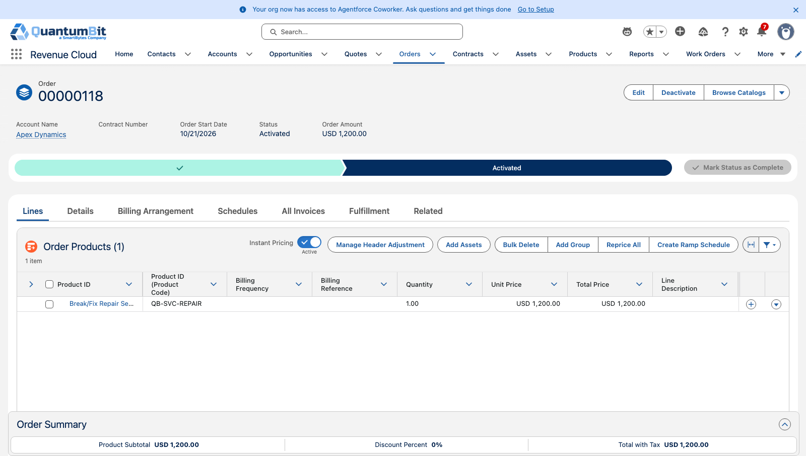
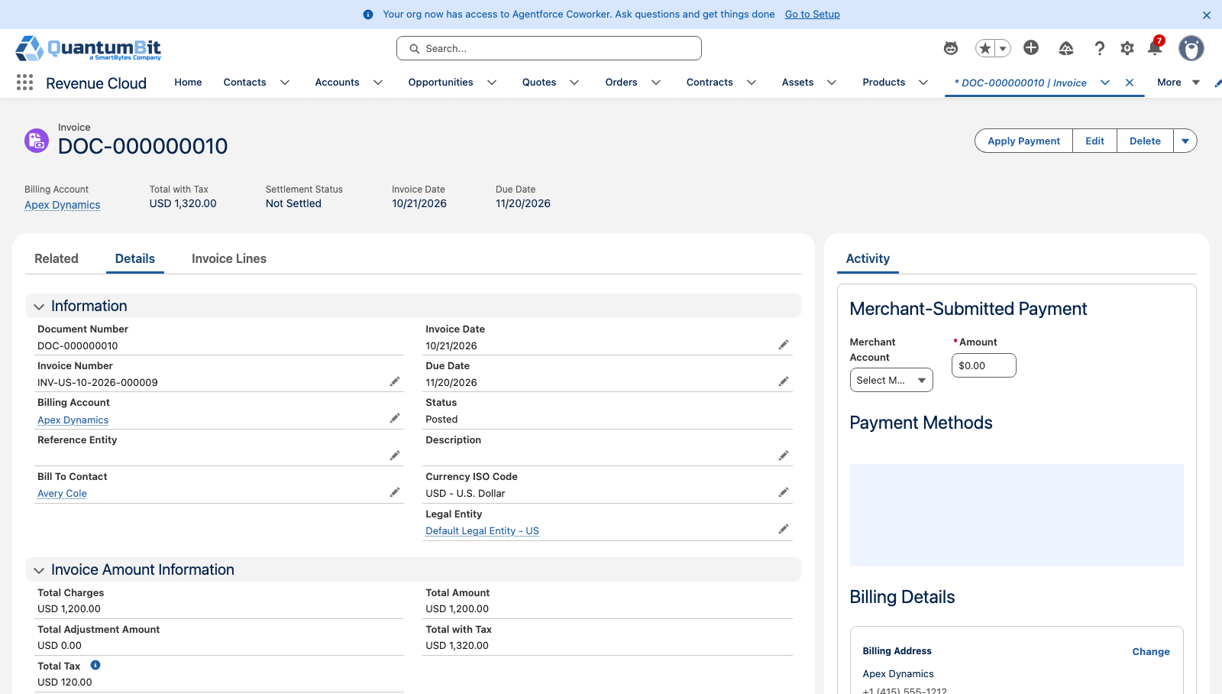
Scene 7 · Break/fix with coverage check
Screenshots from the fsl-rc org run
Break/fix on the Gold asset: Covered
Break/fix for Apex Dynamics, no Gold: Not Covered
Completed uncovered repair with its Billable Order
Repair order
Repair invoice posted

Slide 24
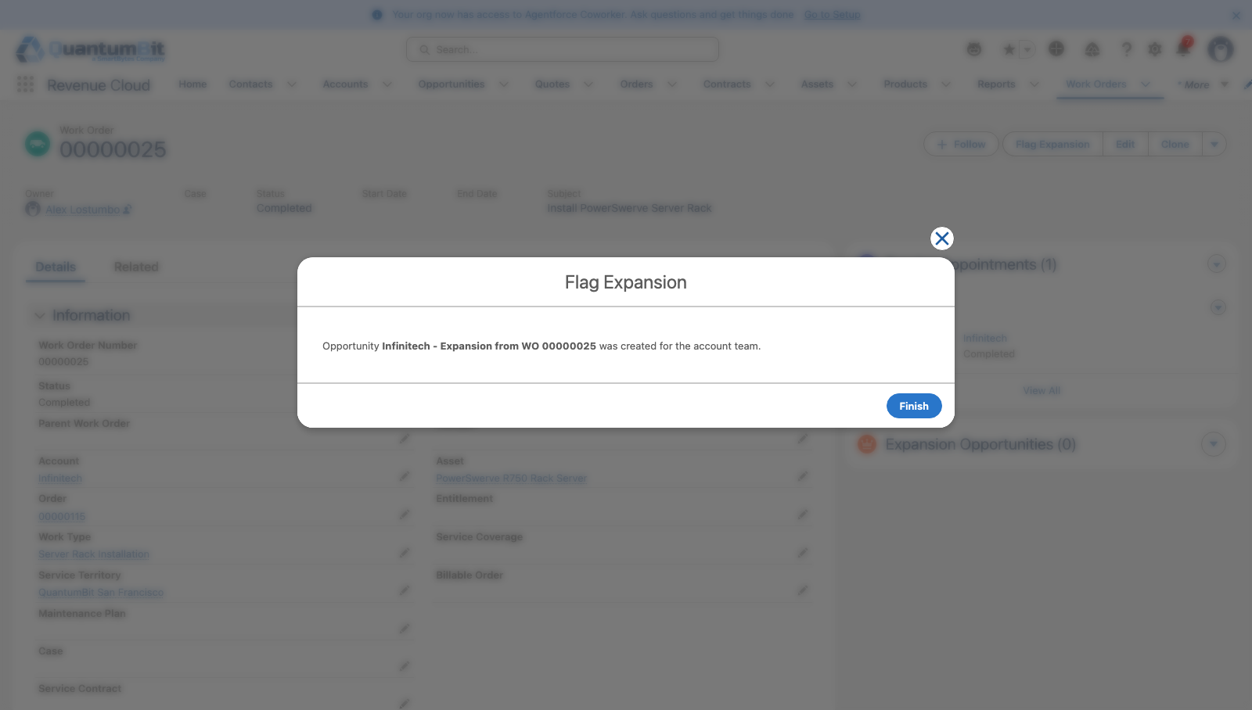
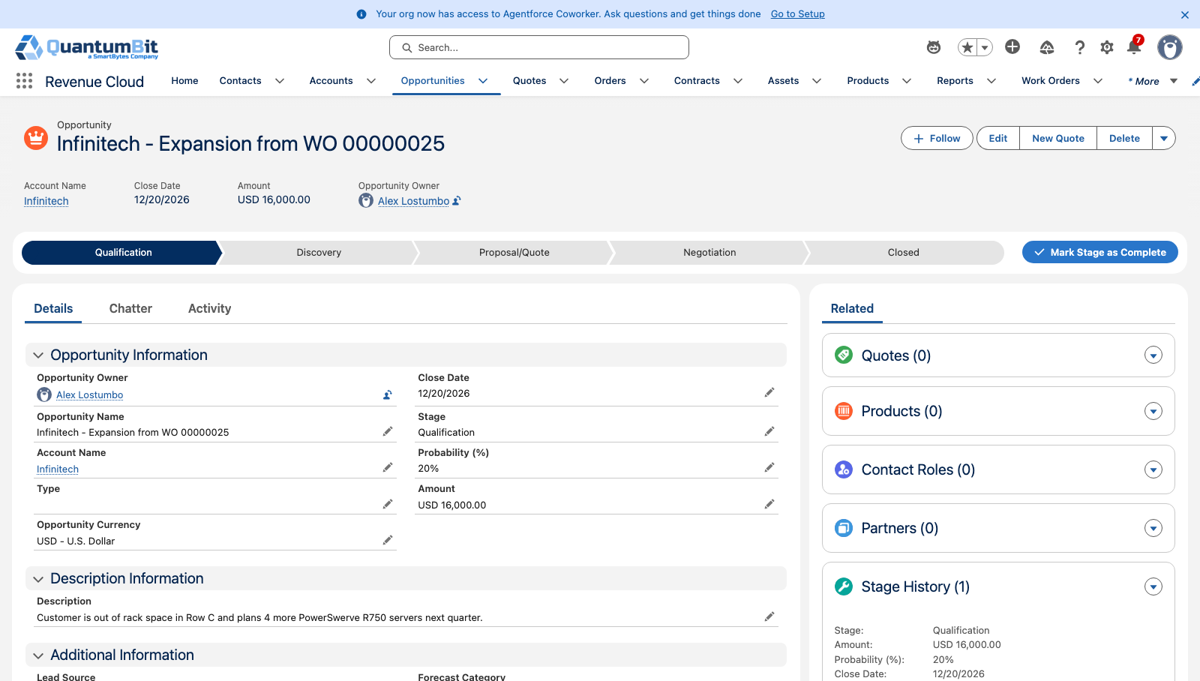
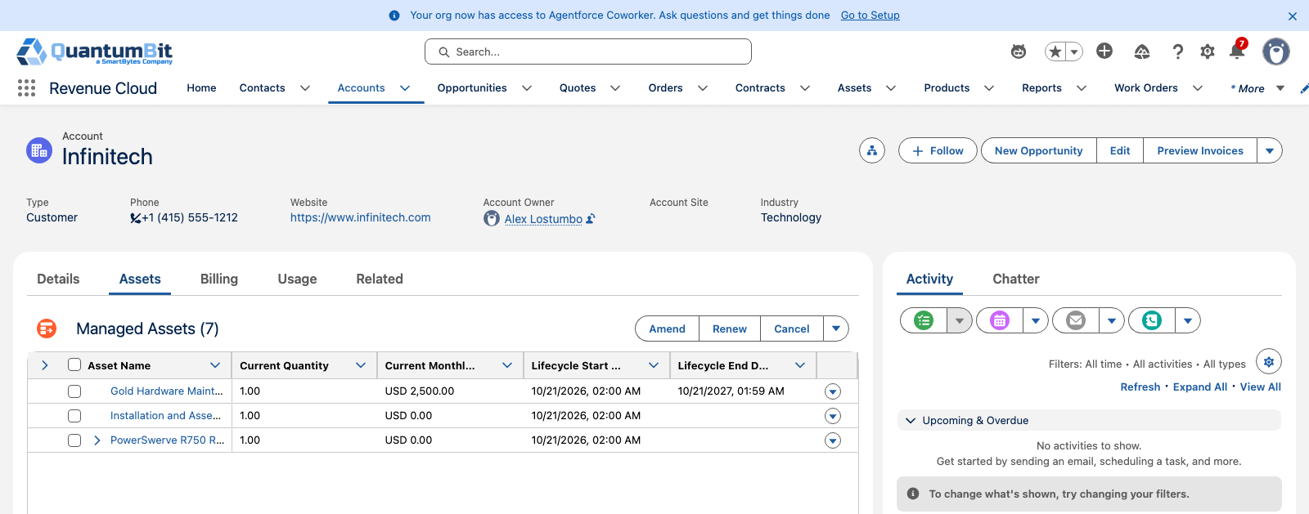
Scene 8 · Upsell from the field
Screenshots from the fsl-rc org run
Flag Expansion from the Work Order
Opportunity created
Expansion opportunity for the seller
Account Assets tab: amend the install base

Slide 25

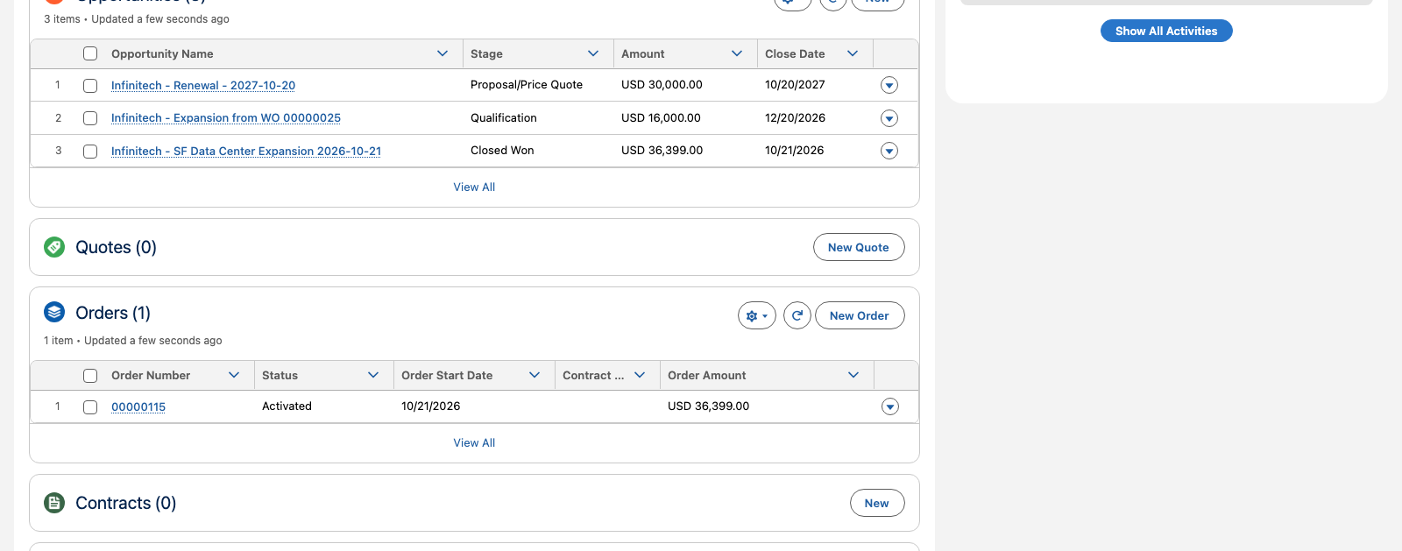
Scene 9 · One install base
Screenshots from the fsl-rc org run
R750 Asset details
Asset: Work Orders, maintenance, entitlements
Account: one order, its opportunities and billing

